Slide 1



Car Fault Finder: Mobile Diagnostic Solution
Car Fault Finder is a comprehensive mobile application designed to help users identify and resolve automobile issues. The app serves as a trusted assistant for diagnosing car problems through multiple approaches, including dashboard warning light recognition, OBD-2 diagnostics, and engine sound analysis.
Developed for a broad spectrum of users from private car owners to professional mechanics, the application combines cutting-edge technology with user-friendly design to make vehicle diagnostics accessible to everyone. Through its intuitive interface and powerful features, Car Fault Finder empowers users with knowledge to maintain their vehicles effectively.
by Group 18

Slide 2






App Identity & Purpose
Diagnostic Assistant
Trusted companion for vehicle diagnosis
Problem Solver
Interprets and resolves dashboard warnings
Vehicle Maintenance
Empowers users with automotive knowledge
The name "Car Fault Finder" clearly communicates the app's primary function as a diagnostic tool. It addresses the common frustration of interpreting complex dashboard warning lights and vehicle faults. By making car diagnostics more accessible, the app helps users save time, reduce stress, and maintain their vehicles more effectively.

Slide 3





Target Audience & Unique Value
Private Car Owners
Individuals seeking to maintain their vehicles and reduce repair costs through early problem detection and DIY solutions.
Professional Drivers
Taxi and ride-share drivers who rely on their vehicles for income and need fast, reliable diagnostics to minimize downtime.
Mechanics & Technicians
Automotive professionals looking for quick reference tools or second opinions to supplement their expertise.
Fleet Managers & Students
Those responsible for multiple vehicles or learning about automotive systems who need comprehensive diagnostic resources.

Slide 4
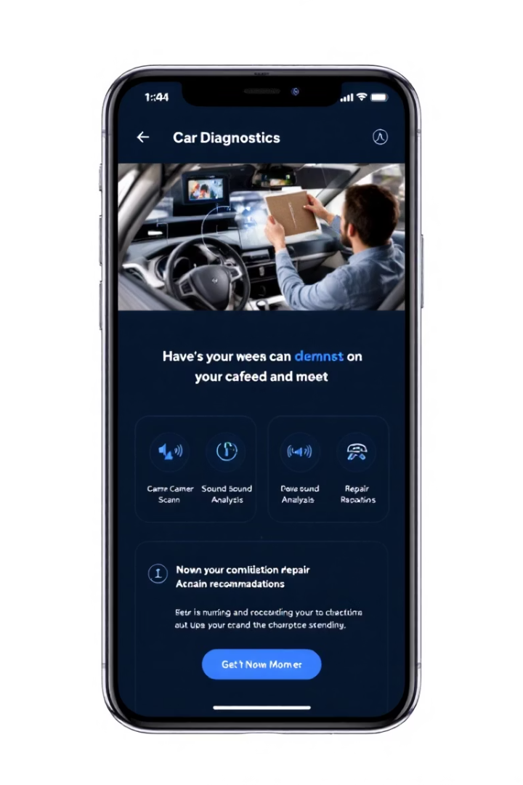




Key Features
Dashboard Light Recognition
Uses smartphone camera and AI to identify warning lights and symbols, with manual browsing options available.
Comprehensive Fault Descriptions
Provides clear explanations of symbols with potential causes categorized by severity levels.
Action Recommendations
Suggests immediate actions, troubleshooting steps, and connects users to nearby service centers.
Engine Sound Analysis
Records and analyzes unusual engine sounds to identify potential mechanical issues using machine learning.

Slide 5
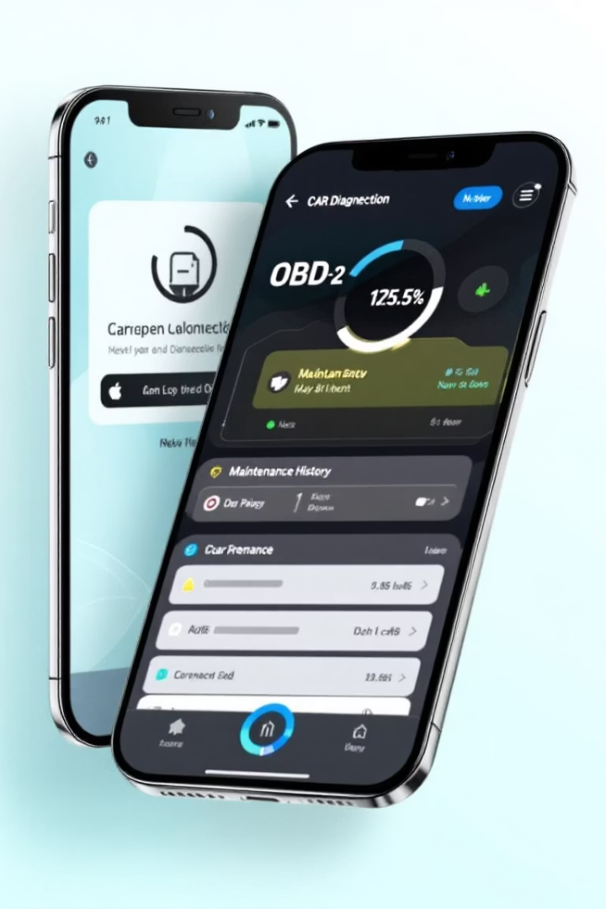
Additional Capabilities
Video Tutorials
Access to step-by-step repair and maintenance videos from verified car experts, helping users perform basic fixes themselves.
OBD-2 Diagnostics
Integration with OBD-2 devices to read and interpret fault codes directly from the vehicle's onboard computer system.
Maintenance History
Track vehicle maintenance records and receive reminders for scheduled service, creating a comprehensive vehicle health log.
Offline Functionality
Essential features remain available without internet connection, ensuring the app is useful during roadside emergencies.

Slide 6
Visual Design
Color Scheme
Typography
The app uses a purposeful color palette:
Roboto font family is used throughout the app with a clear hierarchy:
Orange (#FFA000) for repair icons
Green (#388E3C) for normal status indicators
24-28pt for headers
Blue (#1976D2) for interactive elements
16-18pt for body text
White and light gray backgrounds for readability
12-14pt for captions
This ensures optimal readability across different screen sizes.

Slide 7

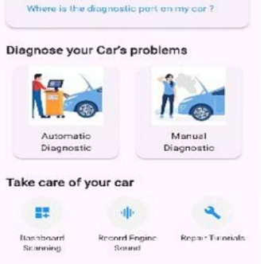
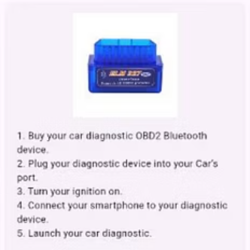

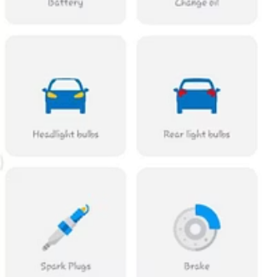
Screen Designs
The app features a clean, intuitive interface with consistent navigation patterns. The splash screen introduces the brand, while the home screen provides quick access to core functions. Specialized screens for diagnostics, maintenance records, and repair tutorials maintain visual consistency while serving distinct purposes.

Slide 8





UX Principles & Implementation
Simplicity
Easy Navigation
Accessibility
Clean layout with minimal clutter, focusing on core functionality and essential information to prevent overwhelming users.
Bottom navigation bar provides quick access to main sections (Home, History, Help) with consistent placement across screens.
High-contrast colors, readable font sizes, and large touch targets ensure the app is usable by people with varying abilities.
Visual Feedback
Loading indicators, animations, and color-coded fault urgency help users understand system status and diagnostic results.

Slide 9
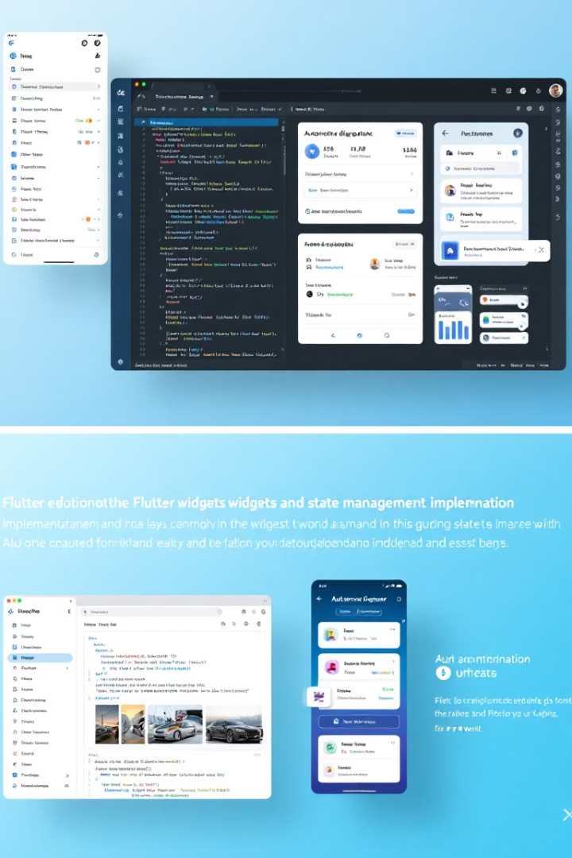
Frontend Implementation
Framework & Structure
Built using Flutter for cross-platform compatibility. The app is organized with separation of concerns, dividing widgets into reusable components like car_care_grid.dart, car_info_card.dart, and diagnostic_option_card.dart.
State Management
Utilizes Provider for lightweight and efficient state sharing between widgets. This enables reactive UI updates when scan results are received and maintains shared history across different screens.
Responsiveness
Ensures compatibility across various screen sizes using MediaQuery, LayoutBuilder, and flexible widgets like Expanded and Flexible. Text sizes scale based on screen dimensions using flutter_screenutil package.

Slide 10








Technical Integration & Future Outlook
Image Recognition
OBD-2 Connection
TensorFlow Lite model processes camera input to identify dashboard symbols
Bluetooth integration for direct vehicle computer communication
Cloud Integration
Audio Analysis
Optional server connection for advanced diagnostics and updates
Machine learning models identify abnormal engine sounds
The Car Fault Finder successfully delivers on its promise of making vehicle diagnostics accessible to everyone. By combining intuitive design with powerful technical capabilities, the app creates a cohesive and user-centered mobile solution. Future development will focus on expanding the diagnostic database, enhancing machine learning models, and adding community features for sharing repair experiences.

